Slide 1
Surveying a Level Loop

Slide 2
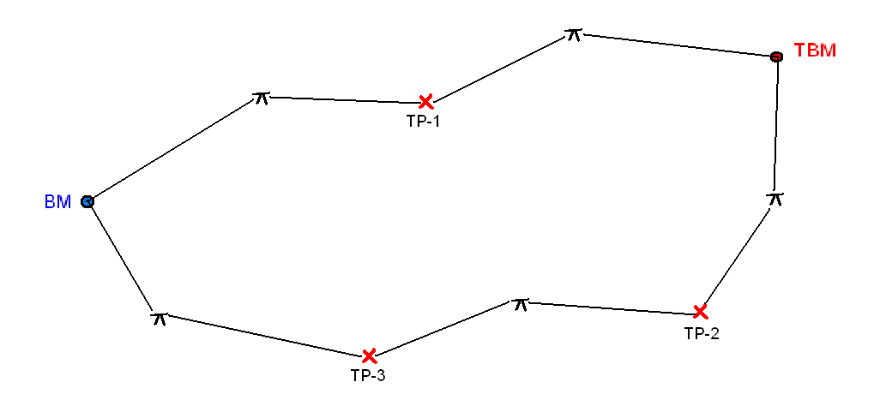
Level Loop (or Closed Circuit)
Instrument location (TYP)
FS =4.26 ft
1
BS = 7.13 ft
Turning Point (TYP)
Elev. 100.00 ft
Notes:
A level loop is a continuous chain of sight lines that form a closed circuit.
Each time the instrument is set up, a backsight and a foresight are taken and recorded. Then the elevation of the turning point can be calculated. For example, for instrument location 1, a backsight of 7.13 ft (click) is recorded to the BM. Then (click) a foresight of 4.26 is recorded at the first turning point (TP-1).

Slide 3
Closed Circuit or Level Loop
 |  | AUTO LEVEL READINGS
 |  |  |  |  | STADIA
PT | (+) BS | HI | (-) FS | ELEV | TOP/BOT STADIA | DIST /Angle
BM |  |  | X | 100.00
7.13
107.13
TP-1
4.26
102.87
Notes:
First, record the POR Elevation and place an x in the FS column for the POR.
Next record the first BS to the POR. (click)
Now calculate the HI. [provide time for students to perform calculation] (click)
Record the FS to TP-1. (click)
Calculate the elevation of TP-1. [provide time for students to perform calculation] (click)

Slide 4
Level Loop (or Closed Circuit)
FS = 2.99 ft
BS = 1.75 ft
2
Turning Point Elev. 102.87
Elev. 100.00 ft
Notes:
Now the instrument is moved (click). Since the elevation of TP-1 is known, you may backsight (click) to TP-1 and foresight (click) to the TBM.

Slide 5
Closed Circuit or Level Loop
 |  | AUTO LEVEL READINGS
 |  |  |  |  | STADIA
PT | (+) BS | HI | (-) FS | ELEV | TOP/BOT STADIA | DIST /Angle
BM |  |  | X | 100.00
7.13
107.13
TP-1
1.75
104.62
4.26
102.87
TBM
2.99
101.63
Notes:
Record the BS to the TP-1. (click)
Now calculate the HI. [provide time for students to perform calculation] (click)
Then record the FS to TBM. (click)
Calculate the elevation of TBM. [provide time for students to perform calculation] (click)
In order to verify that we did not make an error in the process, continue relocating the instrument and taking backsights and foresights until a foresight reading can be taken for the POR. Note that we assume we do not know the BM elevation on the return in order to calculate the POR elevation. Then we can compare the calculated elevation to the actual POR elevation.

Slide 6
Level Loop (or Closed Circuit)
BS = 5.62 ft
Elev. 101.63 ft
Elev. 100.00 ft
3
FS = 3.34 ft
BS = 0.94 ft
BS = 9.12 ft
4
5
FS = 6.01 ft
FS = 7.98 ft
Notes:
The loop is continued until a foresight is taken on the original POR. Record these backsights and foresights in the field notes table (not on your sketch), calculate each HI and turning point elevation, and then calculate the elevation of the BM.

Slide 7
Closed Circuit or Level Loop
 |  | AUTO LEVEL READINGS
 |  |  |  |  | STADIA
PT | (+) BS | HI | (-) FS | ELEV | TOP/BOT STADIA | DIST /Angle
BM |  |  | X | 100.00
7.13
107.13
TP-1
1.75
104.62
4.26
102.87
TBM
5.62
107.25
2.99
101.63
TP-2
0.94
102.18
6.01
101.24
TP-3
9.12
103.32
7.98
94.20
POR
3.34
99.98
Notes:
If you complete the field notes properly, you should end up with a POR elevation of 99.98 ft.
The actual elevation is 100.00 ft. There is a small error.

Slide 8
Closure Error
The difference between a measured or calculated elevation and the true or established elevation.
Closure Error = Final Elev. – Initial Elev.

Slide 9
Closed Circuit or Level Loop
 |  | AUTO LEVEL READINGS
 |  |  |  |  | STADIA
PT | (+) BS | HI | (-) FS | ELEV | TOP/BOT STADIA | DIST /Angle
BM |  |  | X | 100.00
7.13
107.13
TP-1
1.75
104.62
4.26
102.87
TBM
5.62
107.25
2.99
101.63
TP-2
0.94
102.18
6.01
101.24
TP-3
9.12
103.32
7.98
94.20
POR
3.34
99.98
- 100.00
CLOSURE ERROR = - 0.02 ft
Notes:
Show the closure error in the field notes.
Rewrite the original POR elevation under the final elevation. (click)
Then subtract the original elevation from the final elevation. (click)

Slide 10
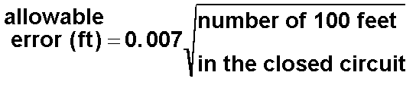
Allowable Error
The allowable error depends on the type and purpose of the surveying.
In this class, we will use

Slide 11
Closed Circuit or Level Loop
 |  | AUTO LEVEL READINGS
 |  |  |  |  | STADIA
PT | (+) BS | HI | (-) FS | ELEV | TOP/BOT STADIA | DIST /Angle
BM |  |  | X | 100.00 | BS 8.63 / 5.63 | 300 ft
 |  |  |  |  | FS 5.69 / 2.83 BS 3.15 / 0.25 | 286 ft 290 ft
 |  |  |  |  | FS 4.44 / 1.54 BS 6.67 /4.57 | 290 ft 210 ft
 |  |  |  |  | FS 7.08 / 4.94 BS 1.84 / 0.04 | 214 ft 180 ft
 |  |  |  |  | FS 8.94 / 7.02 BS 10.42 / 7.82 | 192 ft 260 ft
 |  |  |  |  | FS 4.58 / 2.10 | 248 ft
7.13
107.13
TP-1
1.75
104.62
4.26
102.87
TBM
5.62
107.25
2.99
101.63
TP-2
0.94
102.18
6.01
101.24
TP-3
9.12
103.32
7.98
94.20
POR
3.34
99.98
- 100.00
TOTAL = 2470 ft
CLOSURE ERROR = - 0.02 ft
Notes:
Assume that the distances for each sighting were estimated using the stadia readings as shown OR were measured using a tape. Remember that the approximate distance from the instrument to the rod is equal to the difference between the stadia readings times the stadia multiplier (usually 100).
You will also need two distances to each turning point, one from each adjacent instrument setting.
The total distance around the loop is 2470 ft.

Slide 12
Level Loop (or Closed Circuit)
Instrument location (TYP)
290 ft
290 ft
286 ft
Elev. 101.63 ft
210 ft
300 ft
Elev. 100.00 ft
3
214 ft
248 ft
192 ft
180 ft
260 ft
4
5
Notes:
Record approximate distances on your sketch as they are measured.

Slide 13
Allowable Error
Survey data is acceptable
Notes:
Calculate the allowable error.
Since the closure error for the level loop was 0.02 and it is less than the allowable error, the survey is considered acceptable.

Slide 14
Reducing Errors
Check that bubble is centered for EVERY rod reading.
Keep the rod plumb during each reading.
Establish equal BS and FS reading distances.
Equal reading distances will cancel out any error caused by the line of sight not being parallel with the axis of the bubble tube.
This is not always possible due to terrain.
Notes:
To minimize potential errors when completing a level loop, be careful when taking rod readings.

Slide 15
Common Errors
Faulty rod reading (verify reading)
Rod not fully extended (high reading)
Tripod movement during reading
Confusion between recording BS and FS entries in the field book
Notes:
Some common causes of large closure errors.

Slide 16
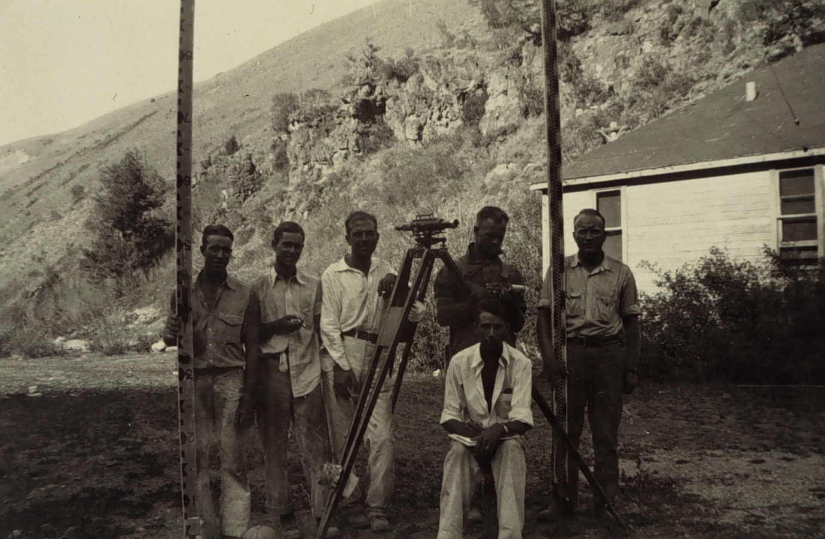
Can You Top That?
Courtesy NOAA Photo Library http://www.photolib.noaa.gov/htmls/theb1809.htm
According to NOAA, this survey party made 329 setups in 7 hours and 55 minutes working in an area of extreme grades in the Western United States in 1934.

Slide 17
Image Sources
National Oceanographic and Atmospheric Administration Photo Library http://www.photolib.noaa.gov/cgs/marks1.html

