Slide 1
Isometric and Oblique Pictorials

Slide 2
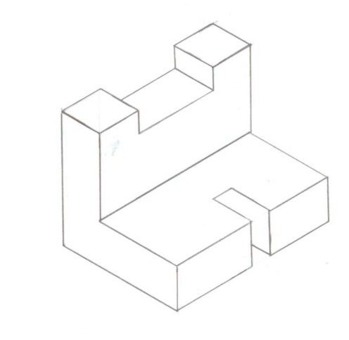
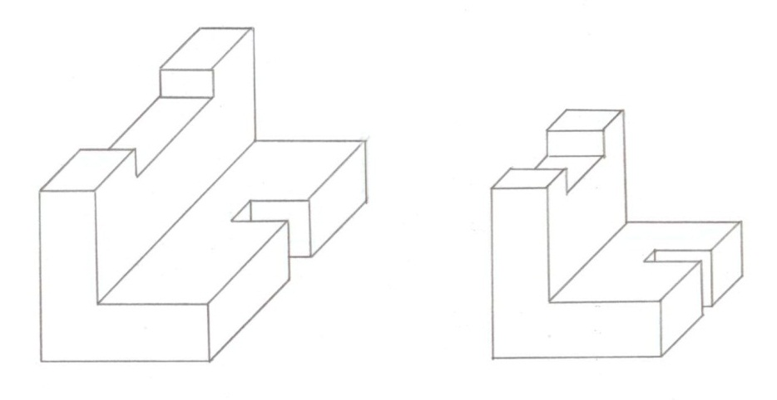
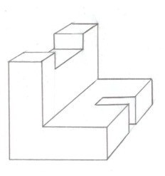
Pictorial Drawing
2D illustration of a 3D object
Shows three faces of an object in one view
Three types
Isometric
Oblique
Perspective
Isometric
Oblique (Cavalier)
Oblique (Cabinet)
Perspective
Notes:
2

Slide 3
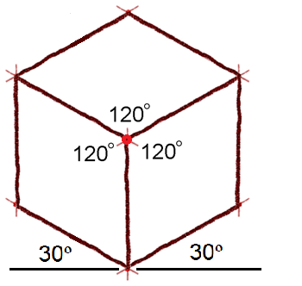
Isometric Pictorial
Isometric means equal measure.
Three adjacent faces on a cube will share a single point
Edges converge at one point will appear as 120 degree angles or 30 degrees from the horizon line
Notes:
3

Slide 4
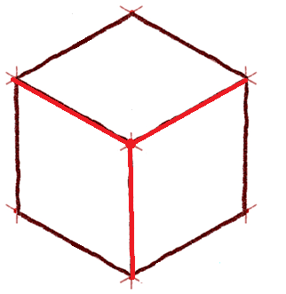
Isometric Pictorial
These three edges represent height, width, and depth
width
depth
height
Notes:
4

Slide 5
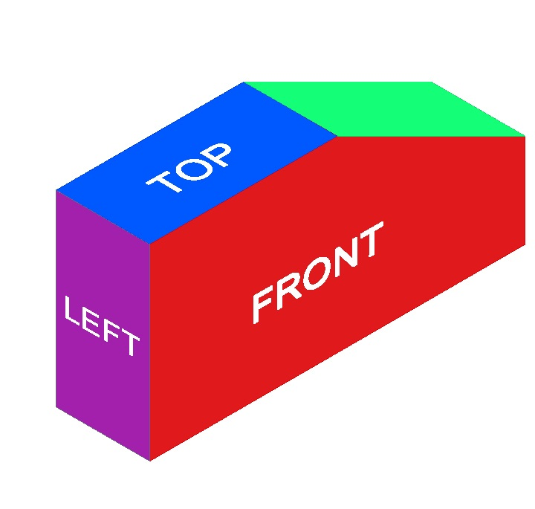
View labels
Top, Front, Right Side view orientation
Top, Left Side, Front, view orientation
Notes:
Isometric views can be presented in two different view orientations. We will use the Top, Front, Right Side view orientation exclusively in IED.

Slide 6
View Selection
Recommendations for how to select the front view
Most natural position or use
Shows best shape and characteristic contours
Longest dimensions
Fewest hidden lines
Most stable and natural position
Notes:
The view of the side that provides the most information about the object is generally chosen as the FRONT view. Finding the best front view of a part can be difficult. Two or more sides may look like the best solution for a front view.
When selecting a front view, compare all side views and choose a front view based on the list of criteria in this list.

Slide 7
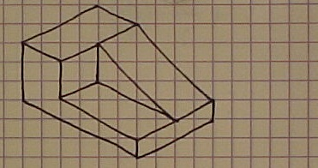
Orthographic View Selection
No hidden edges
Best shape
Description
BEST FRONT VIEW
Most natural position
Longest Dimension
Notes:
We will use the Top, Right Front view orientation. So the view that is chosen as the front view should be drawn facing to the left-front in an isometric view as shown here.

Slide 8
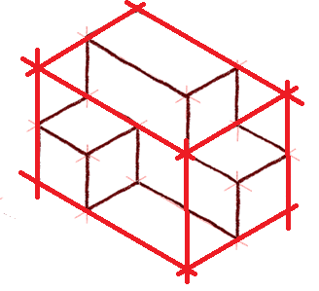
The Box Method
The box method is a sketching technique used to maintain proportionality
It starts with a sketcher envisioning an object contained within an imaginary box
Notes:
8

Slide 9
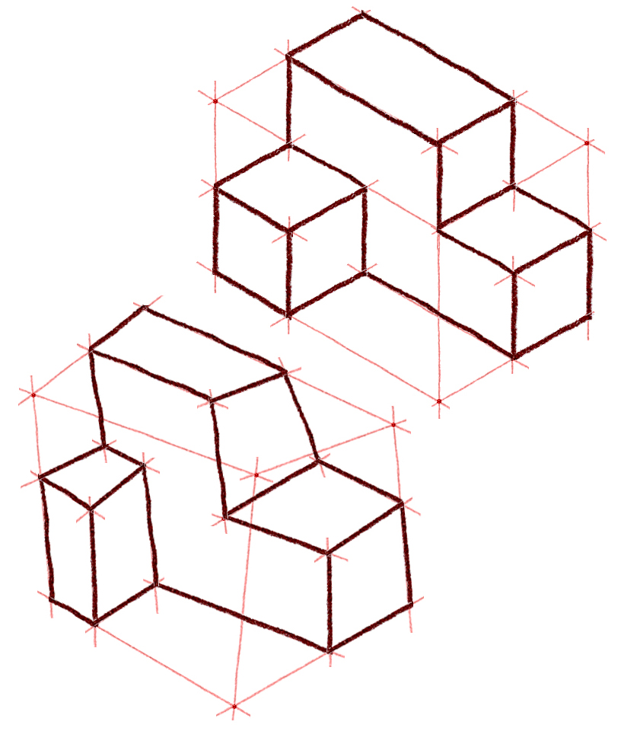
Proportion and Estimation
Good sketching requires a sense of proportion, and the ability to estimate size, distance, angles, and other spatial relationships
Notes:
9

Slide 10
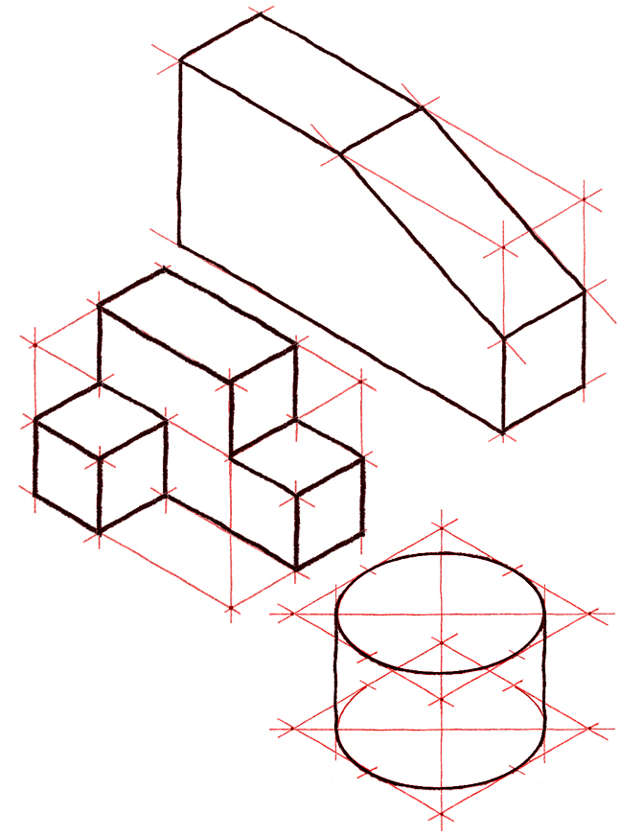
Isometric Sketching
The following examples show steps used to create isometric sketches of simple geometric objects, including tonal shading techniques
Notes:
10

Slide 11
EXAMPLE 1
Isometric Sketch
Notes:
11

Slide 12
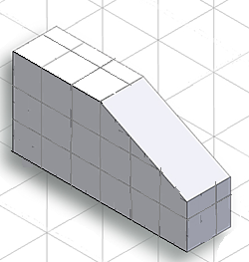
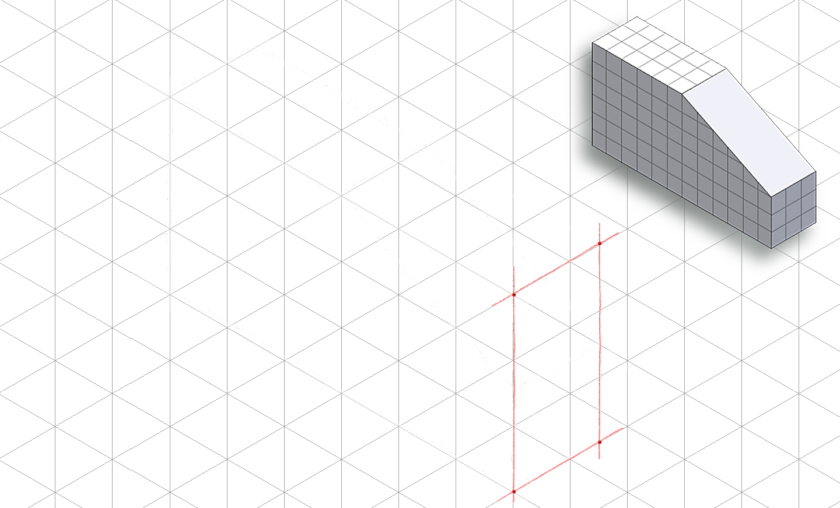
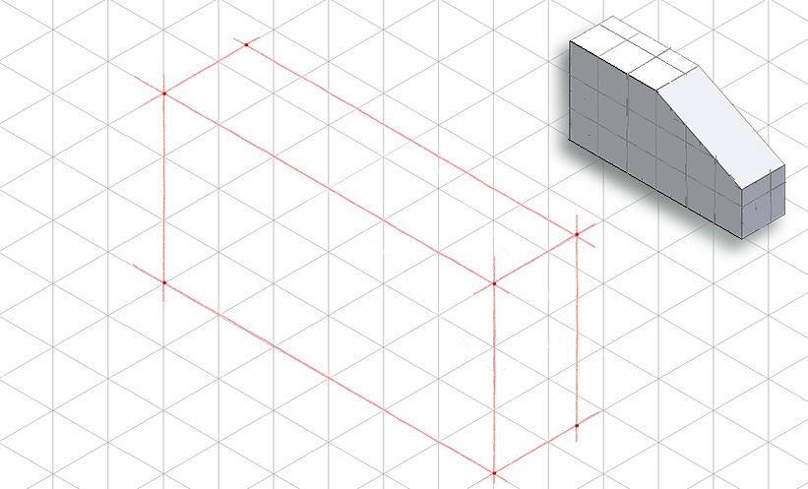
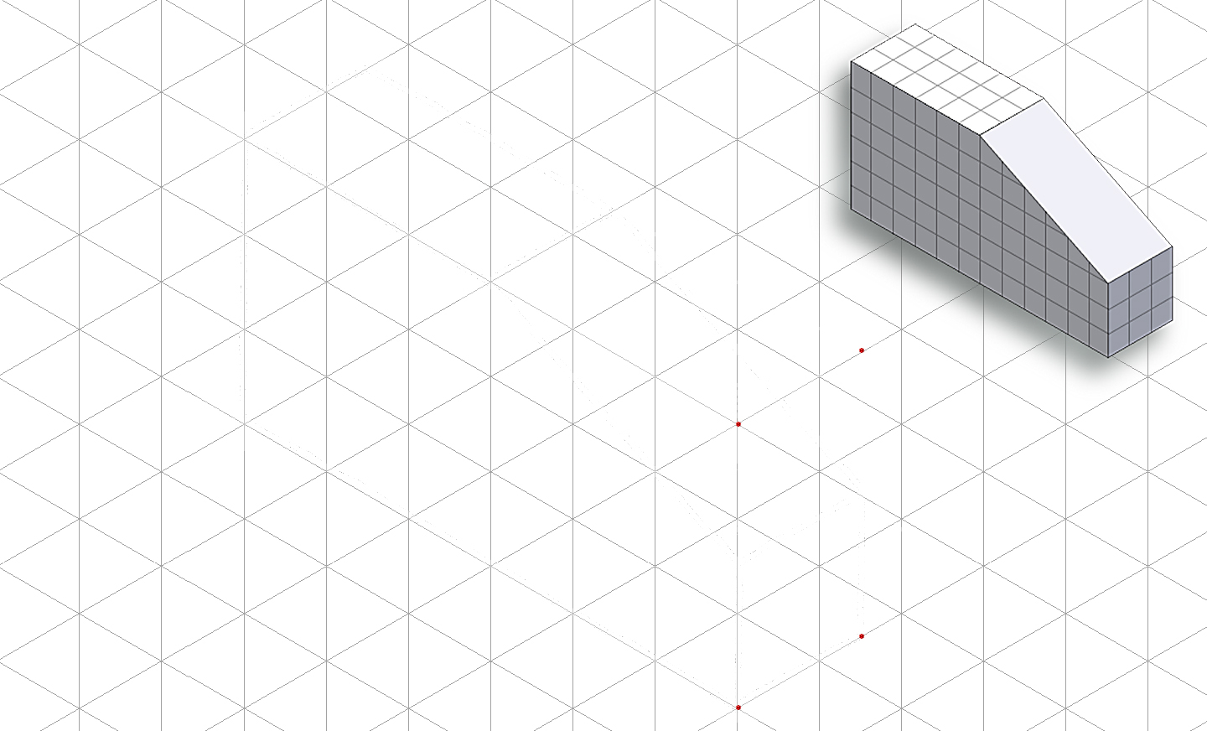
Step 1: Construct the Box
Layout the box that will contain the isometric view using points and construction lines
Notes:
Stress the importance of light construction lines when constructing the box and connecting the points.

Slide 13
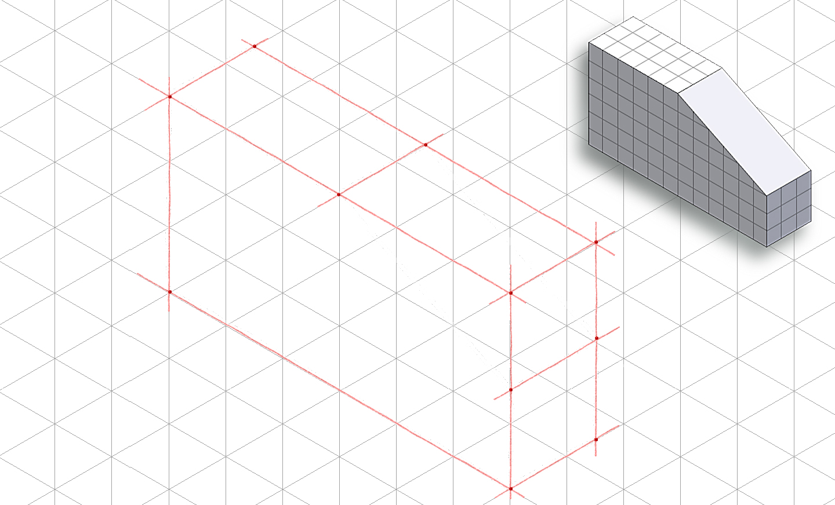
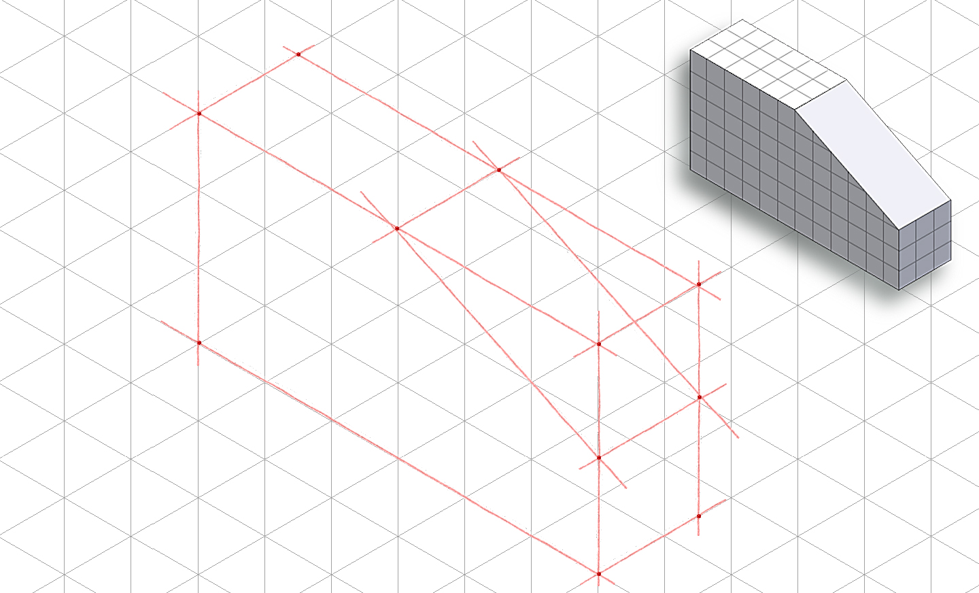
Step 2: Outside Faces
Use points and construction lines to identify corners and edges of object faces that occur on box surface
Notes:
13

Slide 14
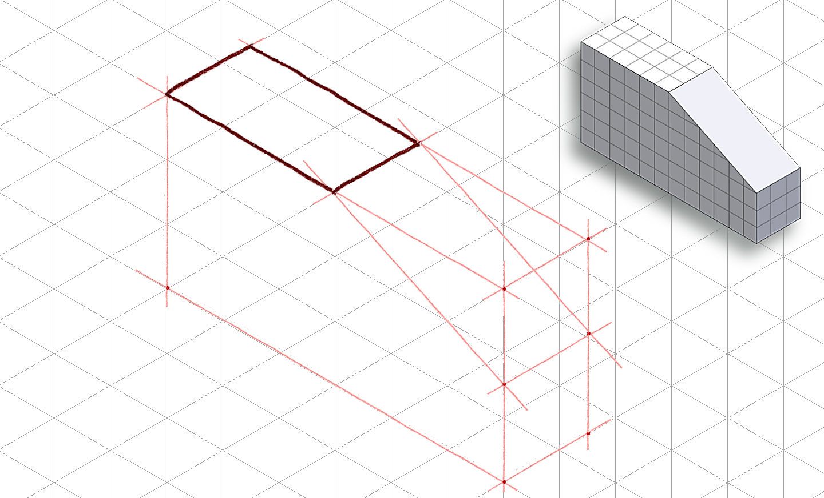
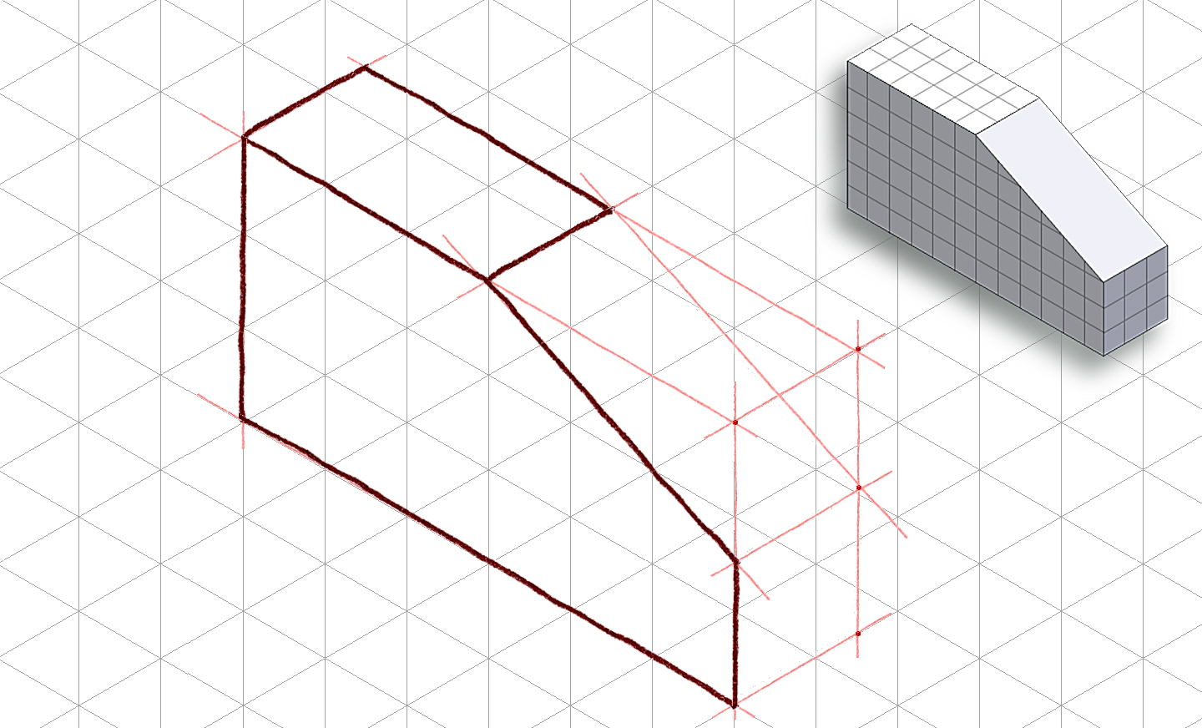
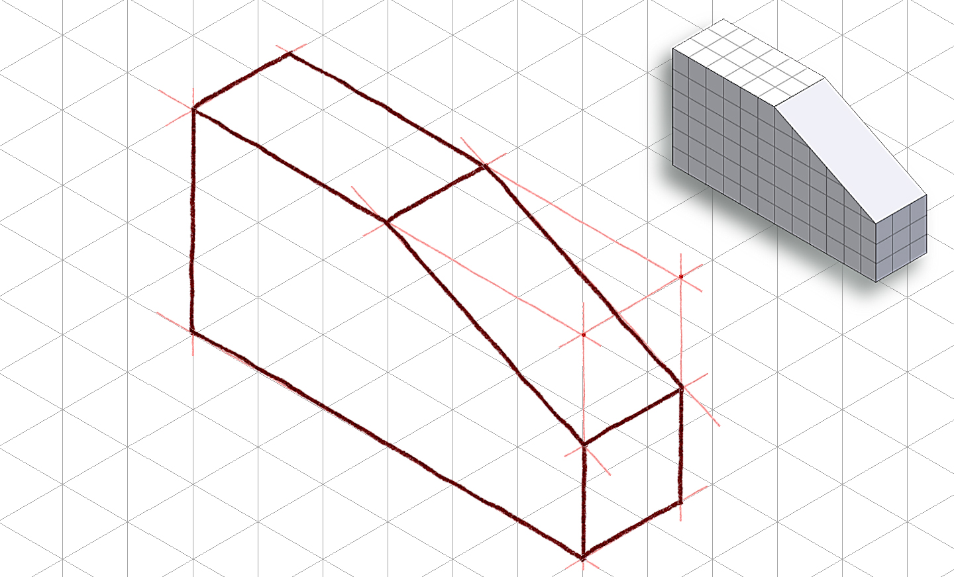
Step 2: Outside Faces (continued)
Trace visible edges of part with thick, dark object lines
Notes:
14

Slide 15
Step 3: Inside Faces
In this case, there are no inside faces
Notes:
You’ll see an example of an isometric sketch with inside faces soon.
15

Slide 16
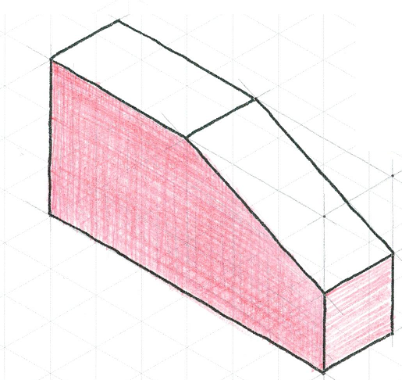
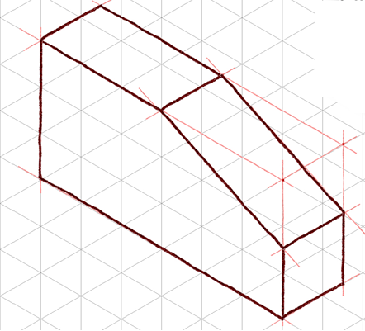
Step 4 - Tonal Shading
Decide the light source position, and add tonal shading to two of the three faces
A shading option is to use parallel lines drawn closely together on a face
Increase contrast by cross-hatching lines on darkest face
Notes:
Tonal shading is a technique that helps enhance the sketch and create a more realistic representation. It imitates reflections and shadows that would naturally occur when a direct light source is introduced.

Slide 17
EXAMPLE 2
Isometric Sketch
Notes:
17

Slide 18
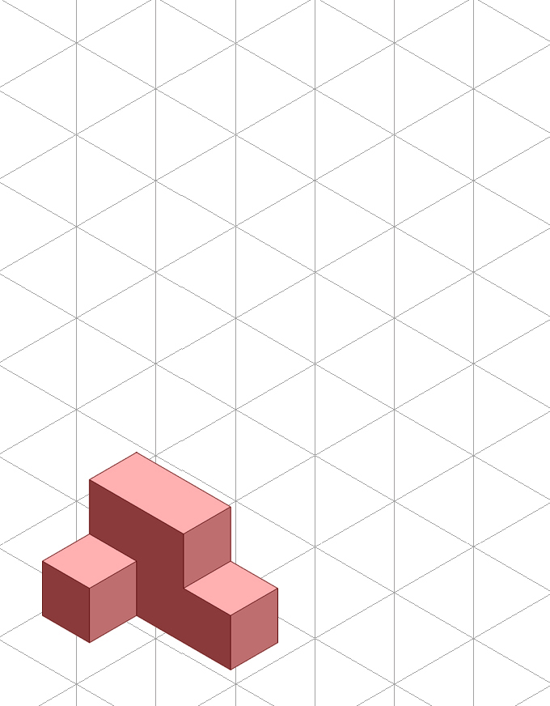
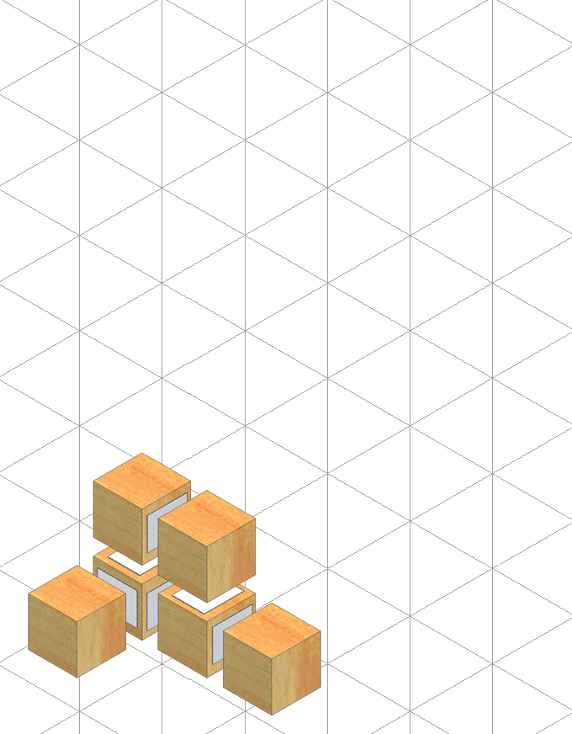
Step 1: Constructing The Box
Determine the overall dimensions of the object:
3 units wide
2 units tall
2 units deep
Use points and construction lines to layout the box.
Notes:
Again light construction lines.
18

Slide 19
Step 2: Outside Faces
Use points and construction lines to identify corners and edges of object faces that occur on surface of the box
Notes:
19

Slide 20
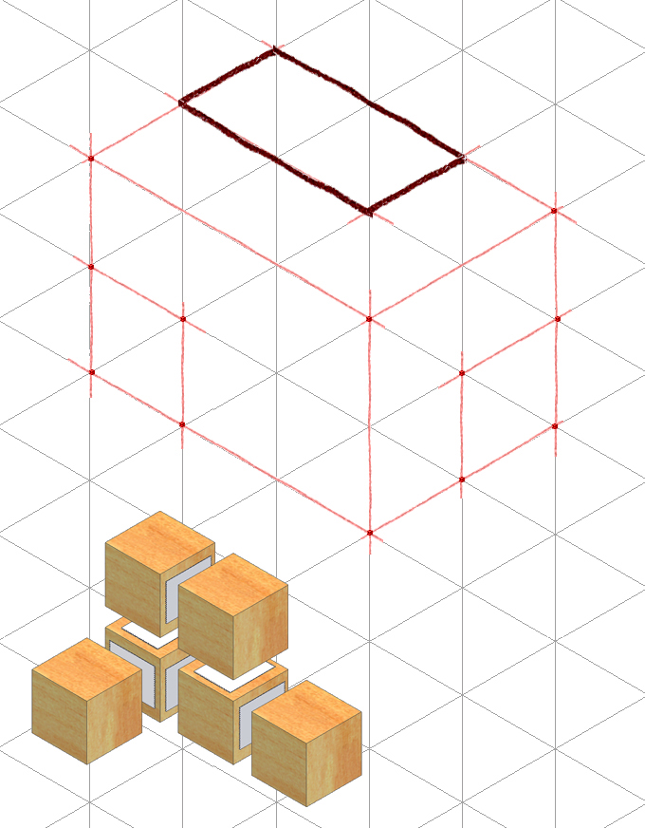
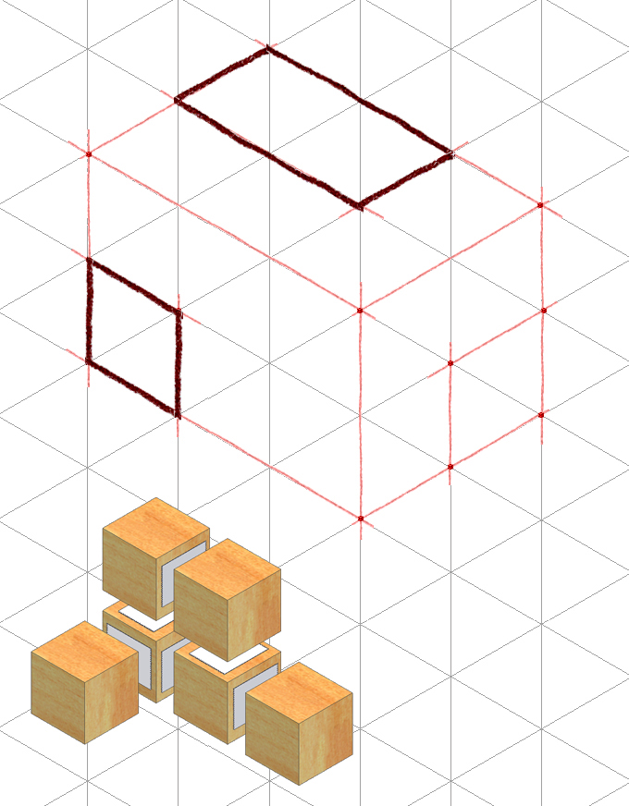
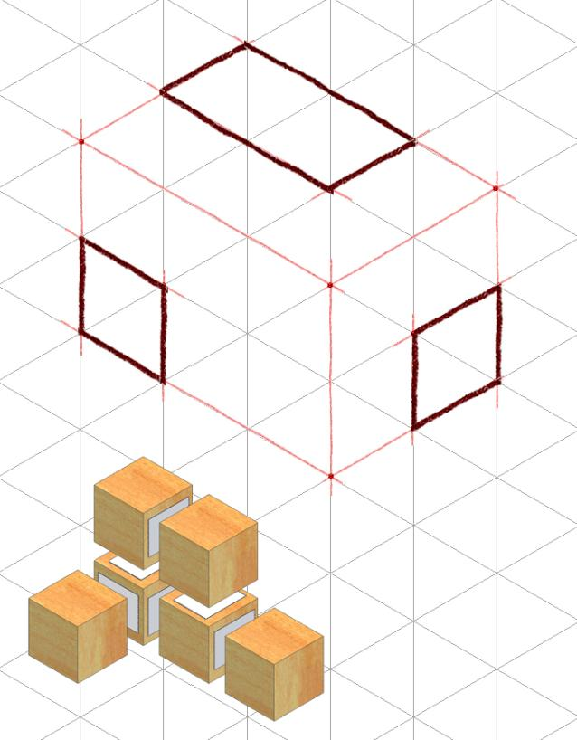
Step 2 – Outside Faces (continued)
Before sketch becomes too congested with construction lines, trace visible edges with object lines
Notes:
20

Slide 21
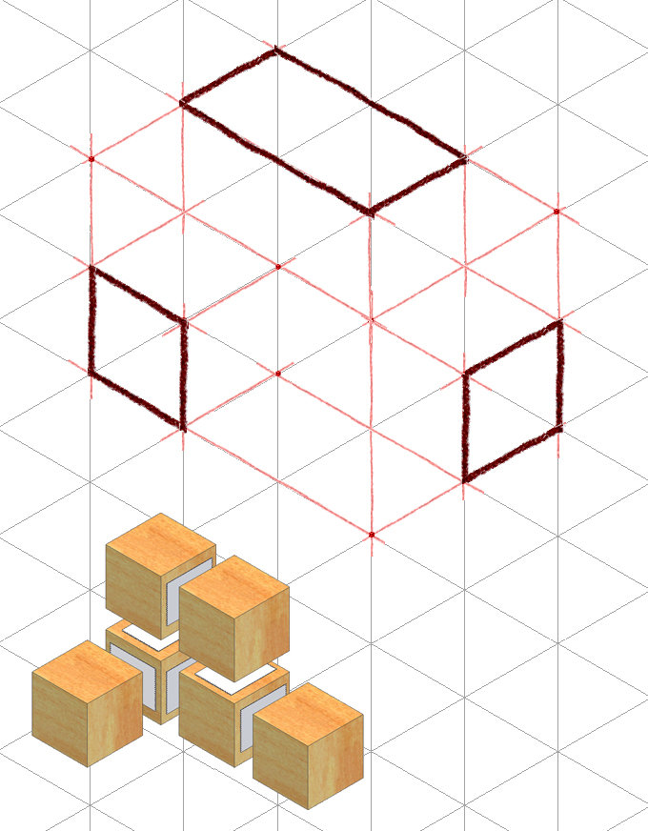
Step 3 - Inside Faces
Use points and construction lines to identify the corners and edges of the object faces that occur inside the box.
Notes:
21

Slide 22
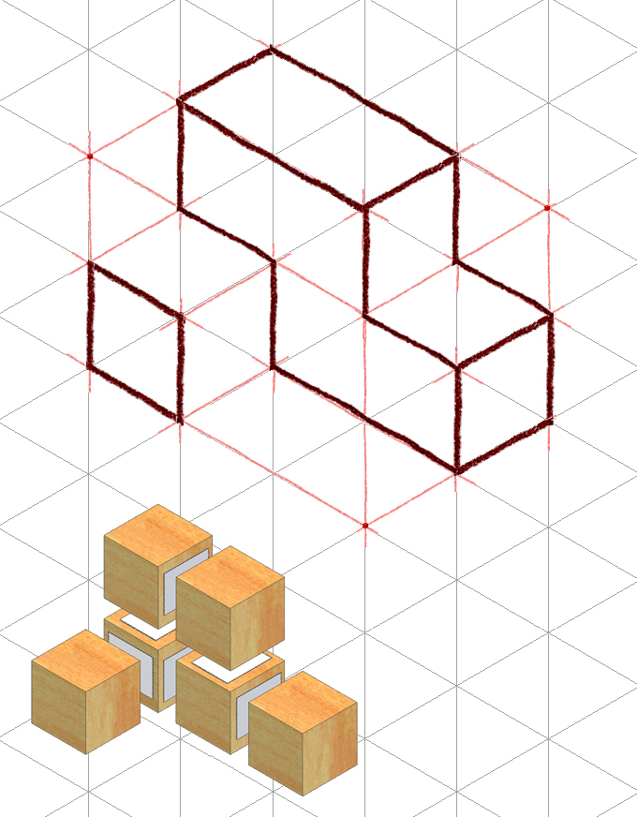
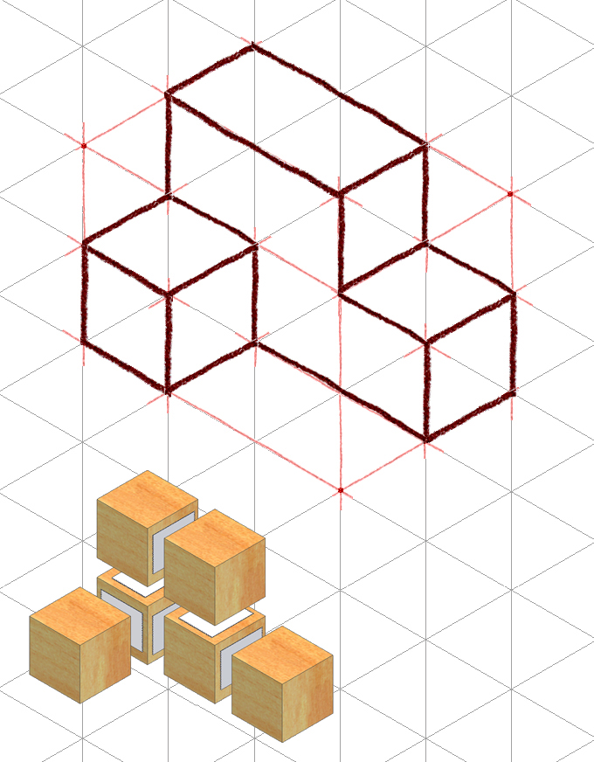
Step 3 - Inside Faces (continued)
Trace out remaining visible edges with object lines
Notes:
22

Slide 23
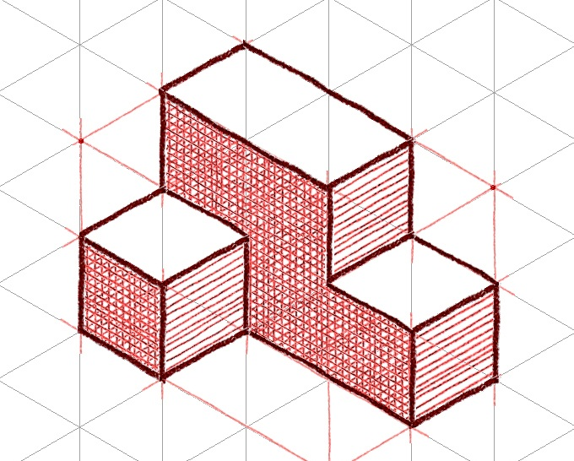
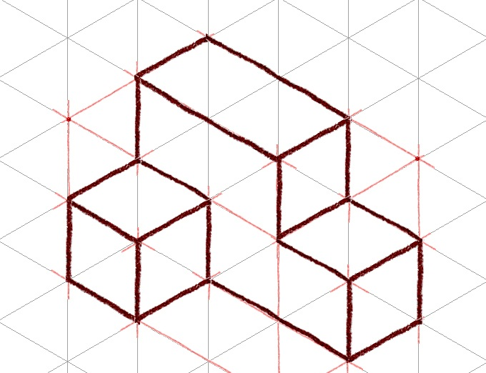
Step 4 - Tonal Shading
Decide the light source position, and add tonal shading to two of the three faces
A shading option is to use parallel lines drawn closely together on a face
Increase contrast by cross-hatching lines on darkest face
Notes:
Again, tonal shading is a technique that helps enhance the sketch and create a more realistic representation. It imitates reflections and shadows that would naturally occur when a direct light source is introduced.

Slide 24
Isometric Sketch Example
Notes:
24

Slide 25
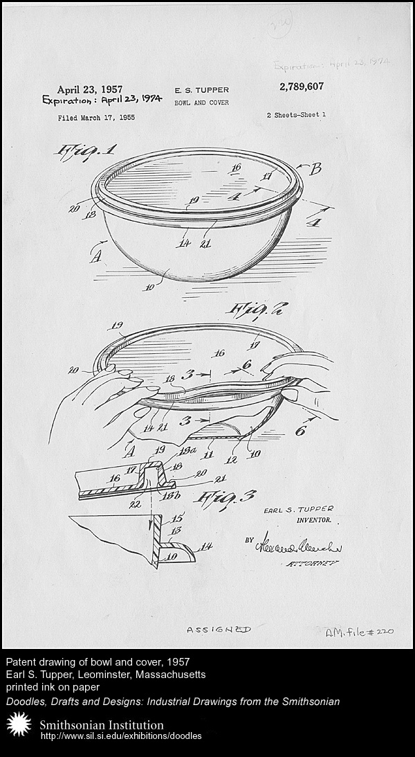
Isometric Sketch Historical Example
Earl Silas Tupper (1907 -1983) invented an air-tight Tupper Seal in 1947
Patent drawings of bowl and cover, 1957 (isometric pictorial)
Courtesy Smithsonian Institute: http://sil.si.edu/exhibitions/doodles
Notes:
25

Slide 26
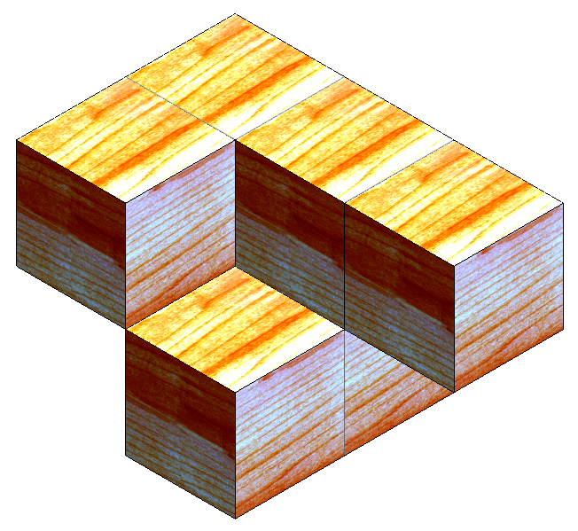
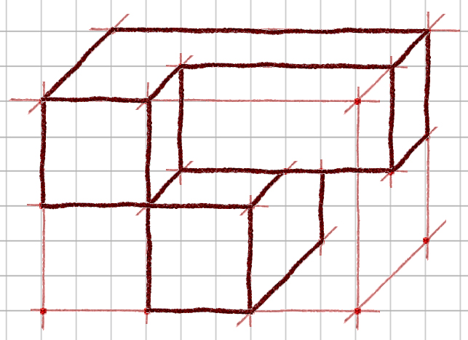
Oblique Pictorials
An Oblique pictorial starts with a straight-on view of one of the object’s faces, which is often the front face
Angled, parallel lines are drawn to one side to represent the object’s depth. Common oblique angles include 30°, 45°, and 60°
45°
Notes:
You may choose to use an oblique representation for design ideas in IED. And, you should be able to identify the two different oblique views – cavalier and cabinet.

Slide 27
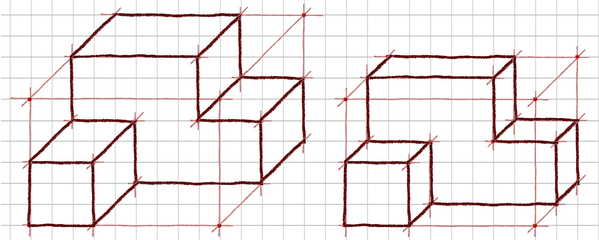
Oblique Pictorials
Two types of oblique pictorials:
Cavalier
Cabinet
The difference between the two is how the depth of the object is represented
Oblique Cavalier
Oblique Cabinet
Notes:
27

Slide 28
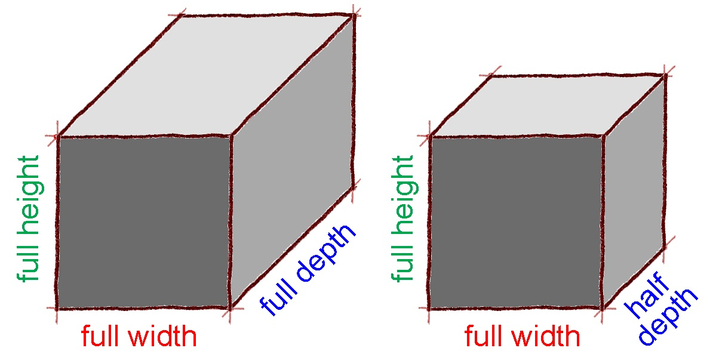
Oblique Pictorials
More realistic view because depth does not appear distorted
Object appears deeper than it actually is
Oblique Cavalier
Oblique Cabinet
Notes:
A cavalier oblique [click] represents the object with full depth [click]. This tends to create the illusion that the object is deeper than it actually is. [click]
A cabinet oblique [click] represents the object with half depth [click]. The cabinet oblique, although actually drawn to half depth provides a more realistic view. [click]

Slide 29
Oblique Pictorials
The following slides show the steps in creating oblique pictorials of the puzzle piece shown below.
Imagine a glass box that encloses the entire object.
Notes:
29

Slide 30
Oblique Pictorials
Sketch a rectangle to represent the overall height and width of “the box” such that height lines are vertical and widths lines are horizontal. This will give a straight on view of the front of the object.
Overall Height
Overall Height
Overall Width
Overall Width

Slide 31
Oblique Pictorials
Overall Depth
Complete “the box” by sketching depth lines to the overall depth of the object at a given angle (45 degrees here).
Cabinet is drawn half depth
Cavalier is drawn full depth
Oblique Cavalier
Oblique Cabinet
Notes:
For the same object, the “front” (straight on) face is drawn the same for the cavalier and the cabinet oblique views.
For a cavalier oblique, the depth of the object is drawn to full scale.
For the cabinet oblique, the depth is drawn to a length of half of the actual depth measurement.

Slide 32
Oblique Pictorials
Sketch points and construction lines to identify the edges of the object faces that occur on the visible surfaces of “the box”.
Cabinet is half depth
Cavalier is full depth
Oblique Cavalier
Oblique Cabinet
Notes:
[Note the shading on the photographic image that is replicated in the sketch.]

Slide 33
Oblique Pictorials
Sketch points and construction lines to identify the edges of the object faces that occur on the visible surfaces of “the box”.
Cabinet is half depth
Cavalier is full depth
Oblique Cavalier
Oblique Cabinet
Notes:
[Note the shading on the photographic image that is replicated in the sketch.]

Slide 34
Oblique Pictorials
Sketch points and construction lines to identify the edges of the object faces that occur on the visible surfaces of “the box”.
Cabinet is half depth
Cavalier is full depth
Oblique Cavalier
Oblique Cabinet
Notes:
[Note the shading on the photographic image that is replicated in the sketch.]

Slide 35
Oblique Pictorials
Use object lines to trace over the construction lines to delineate the edges of the object faces that occur on the visible surfaces of “the box”.
Cabinet is half depth
Cavalier is full depth
Oblique Cavalier
Oblique Cabinet

Slide 36
Oblique Pictorials
Sketch additional construction lines to identify edges of the object inside of the box.
Cabinet is half depth
Cavalier is full depth
Oblique Cavalier
Oblique Cabinet

Slide 37
Oblique Pictorials
Trace over construction lines with object lines to delineate the remaining object lines.
Cabinet is half depth
Cavalier is full depth
Oblique Cavalier
Oblique Cabinet

Slide 38
Oblique Pictorials
Create the Oblique Cabinet view.
Cabinet is half depth
Cavalier is full depth
Oblique Cavalier
Oblique Cabinet
Notes:
Now, you create the cabinet oblique sketch of the puzzle piece.

Slide 39
Oblique Pictorials
You may use tonal shading to enhance the appearance of the perspective sketch and create a more realistic representation.
Cabinet is half depth
Cavalier is full depth
Oblique Cavalier
Oblique Cabinet

Slide 40
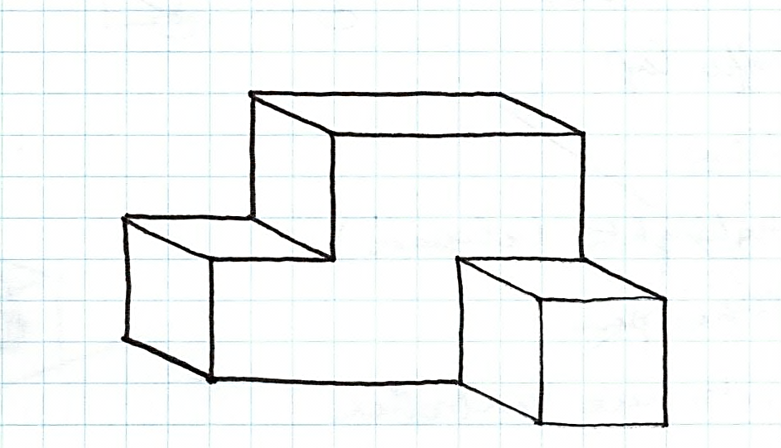
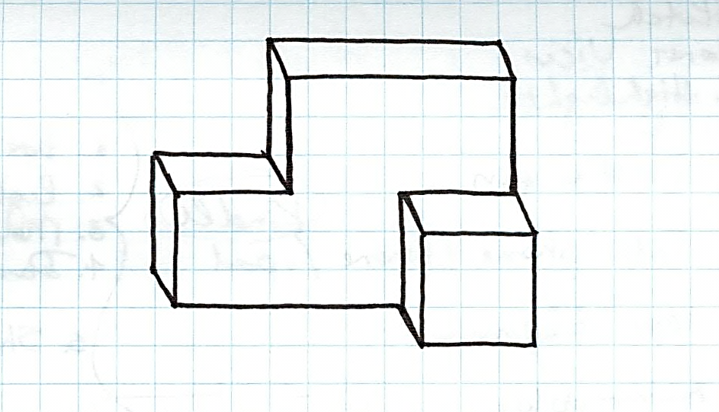
General Oblique
Represents an object’s true width and height, but the depth can be any size and drawn at any angle
Notes:
40

Slide 41
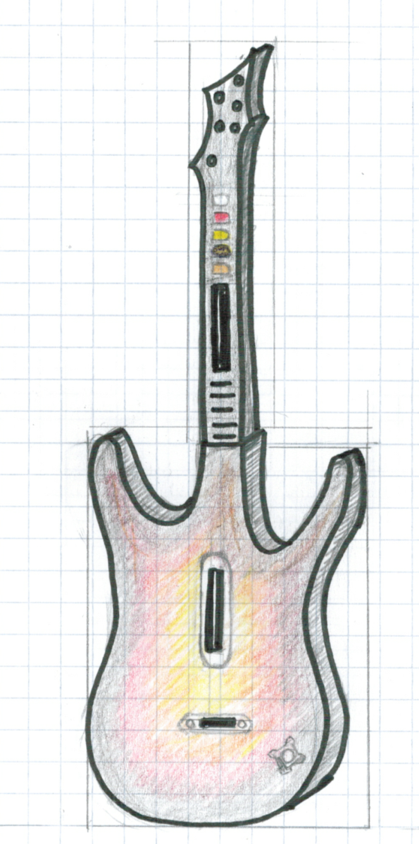
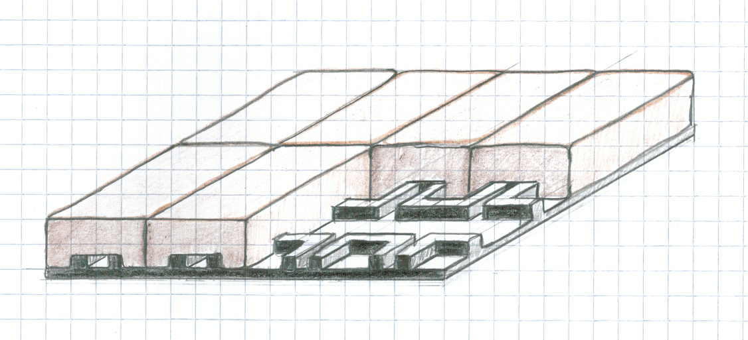
Oblique Pictorials
Examples
Interlocking pavement concept
Game system controller

Slide 42
References
Tupper, Earl Silas. Patent drawings, 1957. Smithsonian Institute: http://sil.si.edu.exhibitions/doodles
Wikipedia (2011). Three point flexural test. Retrieved from http://en.wikipedia.org/wiki/File:Threepoint.jpg
Notes:
42

